Slide 1

Building My First Duplicate Entry Merger Tool
A journey through web scraping, data analysis, and problem-solving as a first-year college student learning to code from scratch.

Slide 2
Starting from Zero
My Reality
As a first-year student, I entered this project with very basic coding knowledge. I quickly realised that breaking down the problem into manageable pieces was key to success.
My Approach
Rather than diving into complex implementations, I divided my project into three distinct phases.
This phased approach helped me learn progressively whilst building confidence with each milestone.

Slide 3
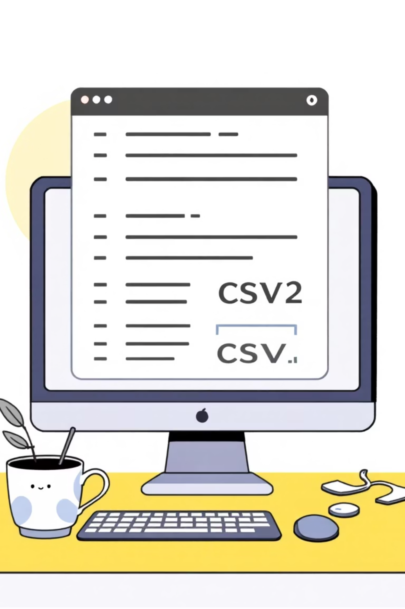
Phase 1: Understanding the Basics
Before tackling massive datasets like Google Shopping, I needed to understand fundamentals. I started small—creating and working with a custom CSV file that I could fully control and comprehend.

Slide 4
Learning by Doing with CSV Files
01
02
03
Data Exploration
Data Cleaning
Data Organisation
I discovered Python libraries like Pandas that made data manipulation surprisingly accessible.
ChatGPT became my coding mentor, explaining concepts as I experimented.
I learnt to filter entries, convert text to lowercase, and remove unnecessary characters like commas, periods, and brackets that cluttered my data.
My code grouped similar product names together, extracting key information like product names, prices, and seller details into organised lists.
Each step taught me something new about how data flows through code.

Slide 5
                Phase 2: Connecting to the Real World
Learning Moment: I discovered that scraping data legally and ethically required understanding APIs and terms of service.
With CSV basics mastered, I faced my biggest challenge: bringing live internet data into our programme. This was the original goal, and it felt both exciting and daunting. Initial research introduced me to web scraping libraries like BeautifulSoup, which opened up possibilities for extracting data directly from websites.

Slide 6
Discovering SerpApi
The Challenge
The Solution
The Implementation
Directly scraping Google Shopping raised legal concerns. I needed a legitimate way to access product listings whilst respecting Google's policies and infrastructure.
SerpApi became my bridge to Google's data. This service legally provides structured access to search engine results, including Google Shopping listings, through a clean API interface.
Instead of parsing raw HTML, SerpApi delivered organised JSON data containing product names, prices, sellers, and ratings—exactly what my comparison tool needed.

Slide 7



Phase 3: Polishing & Integration
File Integration
User Input
Testing
Connected my sorting algorithms with the scraping module for seamless data flow.
Implemented custom search functionality so users could query any product they wanted.
Ran countless tests to identify bugs and improve reliability of results.

Slide 8
Key Challenges I Overcame
🧩 Debugging Errors
📚 Library Documentation
Learning to read error messages and troubleshoot issues that seemed impossible at first.
Understanding technical documentation for Pandas, SerpApi, and other tools without prior experience.
🔄 Data Consistency
Ensuring my programme handled different data formats and unexpected inputs gracefully.

Slide 9
A Working Price Comparison Tool
My final programme accepts user search queries, fetches live product data from Google Shopping via SerpApi, cleans and organises the information, and presents comparable results—all built from scratch by a first-year student.
What I Built
Is it perfect? Absolutely NOT. To be very honest, it is a very basic and a simple
program that just loads data from Google Shopping tab and compares the
price; sorts and merges all the duplicate entries into one and lists the
lowest price available for a particular product at any given point of time.
But it works, and I built it myself with the help of AI of course.

Slide 10
Mohsin Syed
ICE
NIT Trichy

